Slide 1

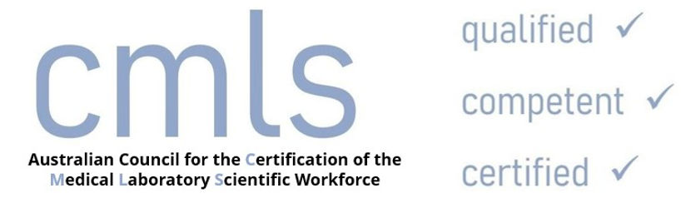
National Certification Scheme for the Medical Laboratory Science Workforce
Tina Pham
St Vincent’s Hospital Melbourne
Notes:
Thank Susan and the organising committee for the opportunity to present today.
My name is Tina Pham. I have been involved with CMLS since 2020, in the capacity of director on the CMLS board and recently as the ACS representative on the APACE committee.
In the next few slides I will go through

Slide 2
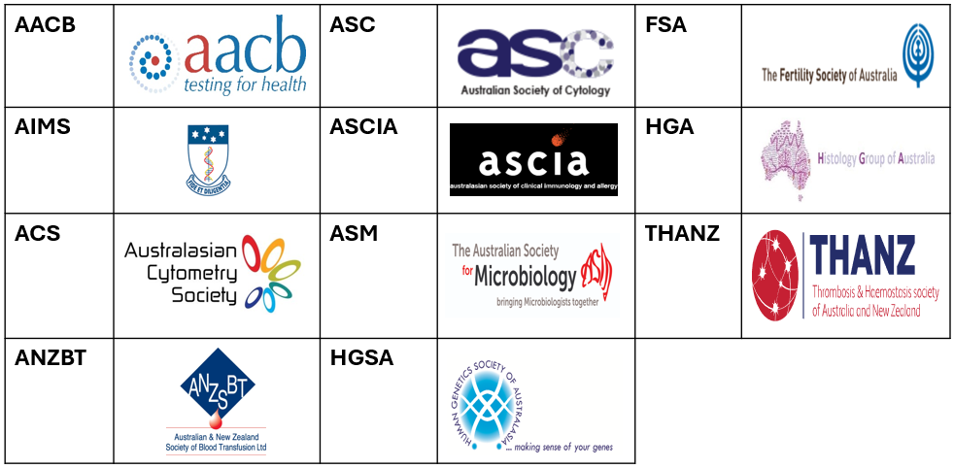
Background
Background
Australia is one of the few developed nations without formal regulation for medical scientists and technical officers.
The government reluctance to regulate aims to avoid administrative costs, focus on high-risk areas, encourage self-regulation, and maintain flexibility in this evolving field.
Initial Launch (2020)
Official introduction of voluntary certification program.
Funded by QUPP and developed through stakeholder collaboration.
CMLS responsible for assessing and issuing certification.
Notes:
Australia is one of the few developed nations that does not formally regulate medical scientists and technical officers.
The government’s reluctance to regulate medical scientists and technical officers is rooted in the desire to avoid administrative costs, focus on high-risk areas (doctors, nurses), promote industry self-regulation, and maintain flexibility in a rapidly evolving field.
Recognizing the need for a system that promotes competency and professional development, the Australian Institute of Medical and Clinical Scientists (AIMS) initiated the development of CMLS certification.
The CMLS framework emerged as part of a larger Quality Use of Pathology Program (QUPP) project in 2020, with extensive consultation across key stakeholders, including government bodies, pathology providers, and scientific organizations.

Slide 3
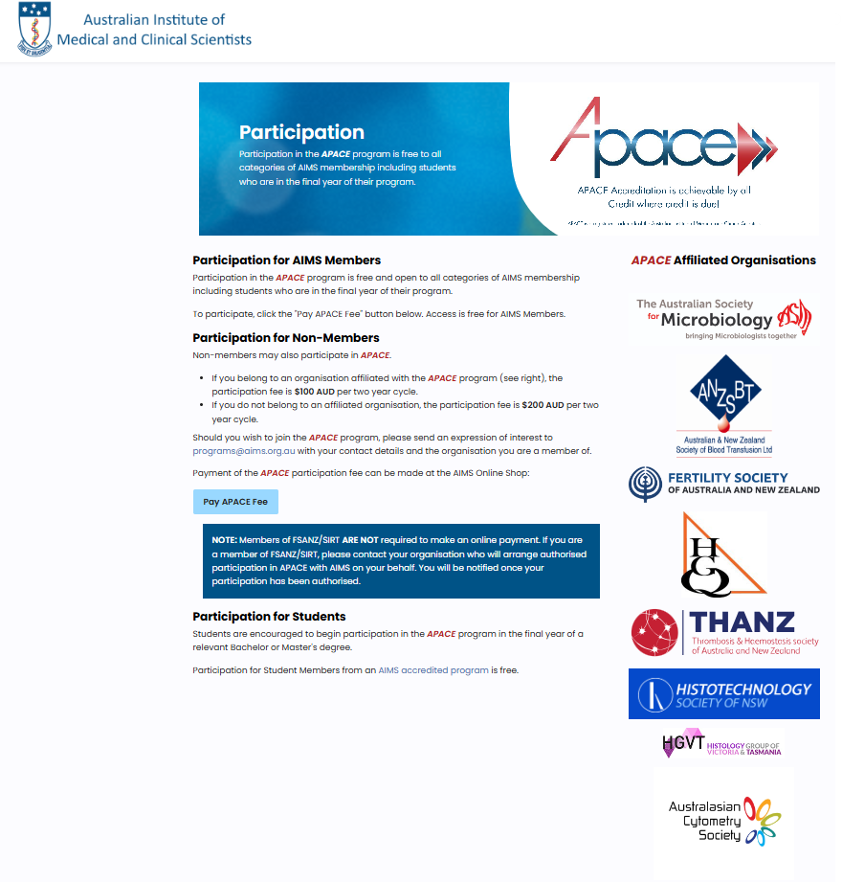
Update
Revised Model (2023)
Professional bodies with CPD programs responsible
for assessing and issuing certification on behalf of CMLS.
(AIMS, AACB, ASC, HGSA)
Current Status (2024)
ACS becomes affiliated with AIMS APACE program.
Certification for ACS members discounted rate of $100
Notes:
Since its launch, CMLS certification has seen several milestones
To increase accessibility and reduce the financial burden on applicants, a cost-reduction model was introduced in mid-2023.
This enabled professional bodies with CPD programs to assess and issue certification on behalf of CMLS. These organisation include AIMS, AACB, ASC and HGSA.
We are excited to announce that the Australasian Cytometry Society (ACS) is now affiliated with the Australian Institute of Medical and Clinical Scientists (AIMS) and its Australasian Professional Acknowledgement and Continuing Education (APACE) program.
As part of this affiliation, ACS members can access APACE and CMLS certification at a discounted rate of $100.

Slide 4
Aim
Ensure professional competency
Promote continuous professional development
Enhance workforce quality & patient outcomes
Support career advancement
Foster self-regulation within the industry
Build public trust in laboratory services
Facilitate workforce mobility
Notes:
The aim of CMLS was to create a voluntary, competency-based certification for medical laboratory professionals to:
Ensure Professional Competency: Provide public assurance that certified individuals meet high standards of knowledge and skills.
Promote Continuous Professional Development: Encourage lifelong learning and engagement in continuing education programs like APACE.
Enhance Workforce Quality: Establish consistent standards across the medical laboratory workforce, improving service delivery and patient outcomes.
Provide Career Advancement Opportunities: Offer recognition that supports career progression and enhances employability.
Support Industry Self-Regulation: Create an industry-driven framework that fosters accountability without requiring formal government regulation.
Increase Public Confidence: Build trust in medical laboratory services by certifying the qualifications and competence of scientists.
Facilitate Workforce Mobility: Standardized certification allows easier recognition of qualifications across organizations and sectors.

Slide 5
Requirement
 | Qualification | Competency | Continuing Professional Development
Technical Officer | VET (AQF 5-6) | Minimum 2 years ** | AIMS APACE * AACB CPD ASC CPD HGSA CDP
Medical Scientist | Degree in Science (AQF level 7-9) | Minimum 2 years ** | AIMS APACE * AACB CPD ASC CPD HGSA CDP
Clinical Scientist | Fellowship Doctorate (AQF level 10) | Minimum 5 years ** | AIMS APACE * AACB CPD 5 ASC CPD HGSA CDP
*Provisional certification available for individuals who haven't met CPD requirements
** Conditional certification available for those who meet qualification requirements but lack requirements for competency and CPD.
Notes:
The requirements …

Slide 6
Process
 | Process
Qualification | Get qualification certificate certified*
Competency | Download checklist from CMLS website -Technician (Generic) checklist -Clinical and Medical Scientist checklist Get supervisor to sign off assessment checklist*
Continuing Professional Development | Enrol in APACE by sending email to programs@aims.org.au Pay $100 for gain APACE access Log CPD into APACE diary. Obtain 100 CEU to meet requirement for certification
*Send to AIMS via email programs@aims.org.au
Notes:
The certification process involves ..

Slide 7
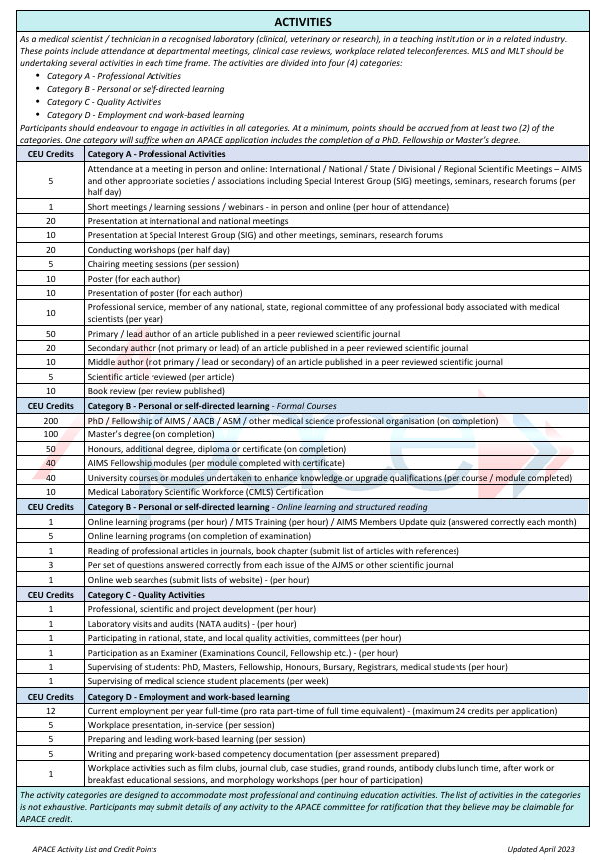
Activity Credit Guide
Notes:
APACE poiHere is the Key Features of the activity credit guide
Activity Categories: The guide categorizes CPD activities, including workshops, seminars, online courses, and self-directed learning, each with designated point values based on time and complexity.
Flexible Learning Options: Professionals can choose from a diverse range of activities to accumulate points, allowing for personalized development aligned with individual career goals and interests.
Only 100 credit are required per 2 year cycel

Slide 8
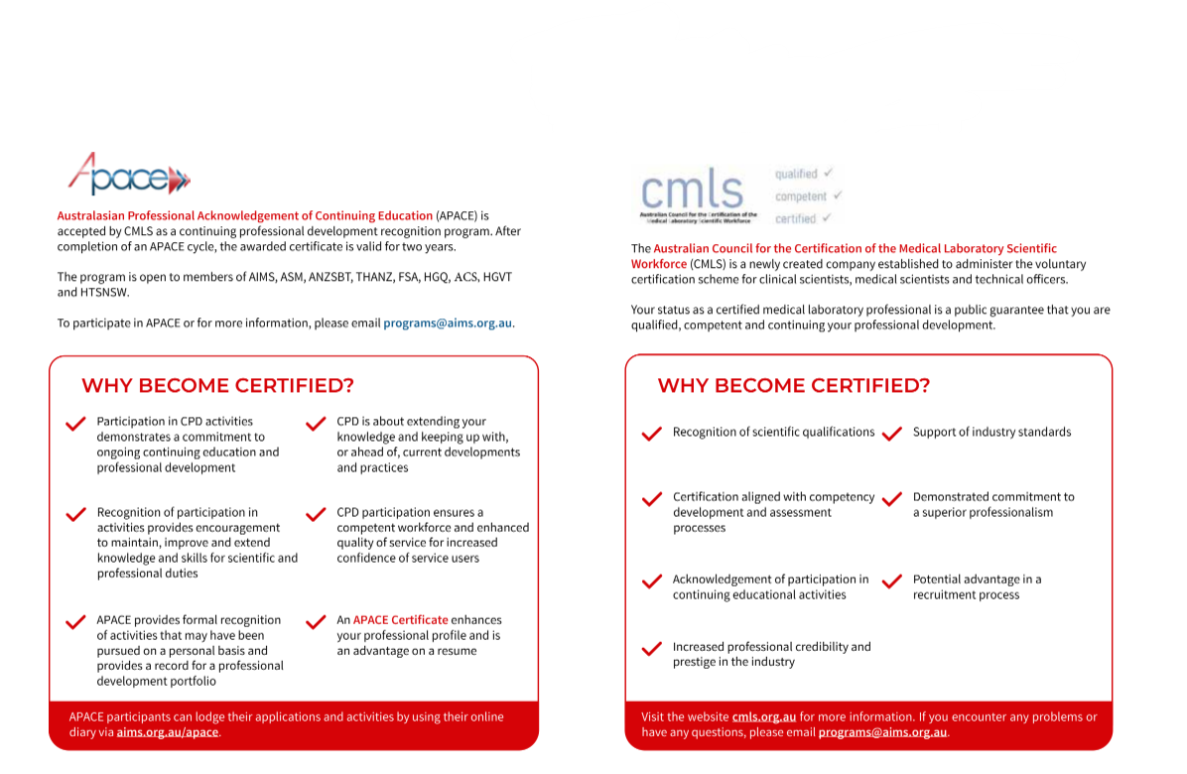
Why Get Certified?
Notes:
Pursuing certification is a strategic decision that enhances your professional credibility and validates your expertise in the field.
Additionally, certification fosters continuous learning and skill development, ensuring that you stay current in a rapidly evolving industry.
By becoming certified, you not only invest in your personal growth but also contribute to the integrity and standards of your profession.
In a competitive job market, certification can be a significant differentiator, making you a more attractive candidate for employers.

Slide 9
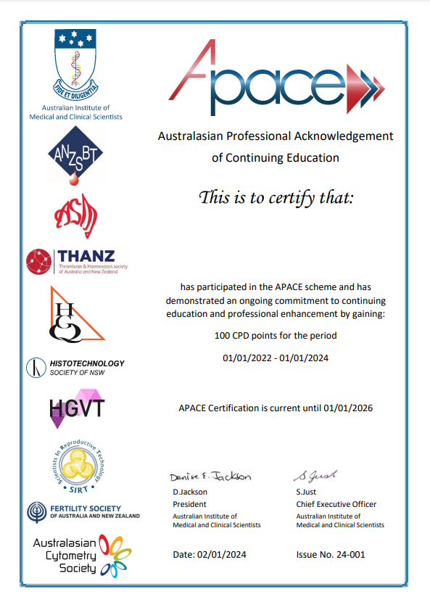
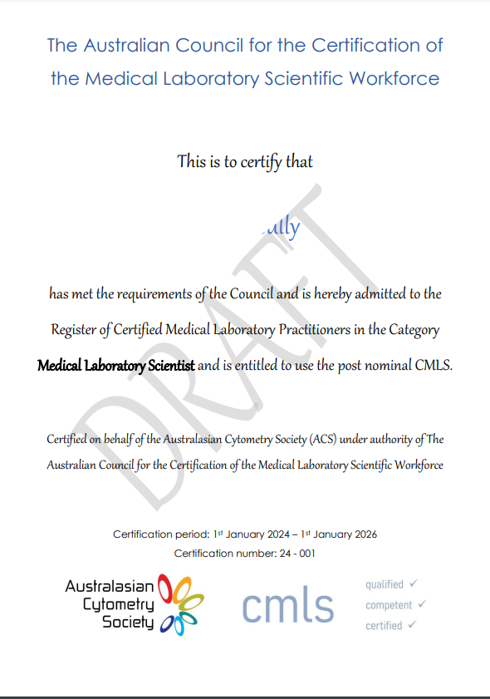
Lets get APACE and go CMLS!
ACS Member
ACS Member
Notes:
Let’s embrace the opportunity and get APACE and go CMLS!

